Slide 1
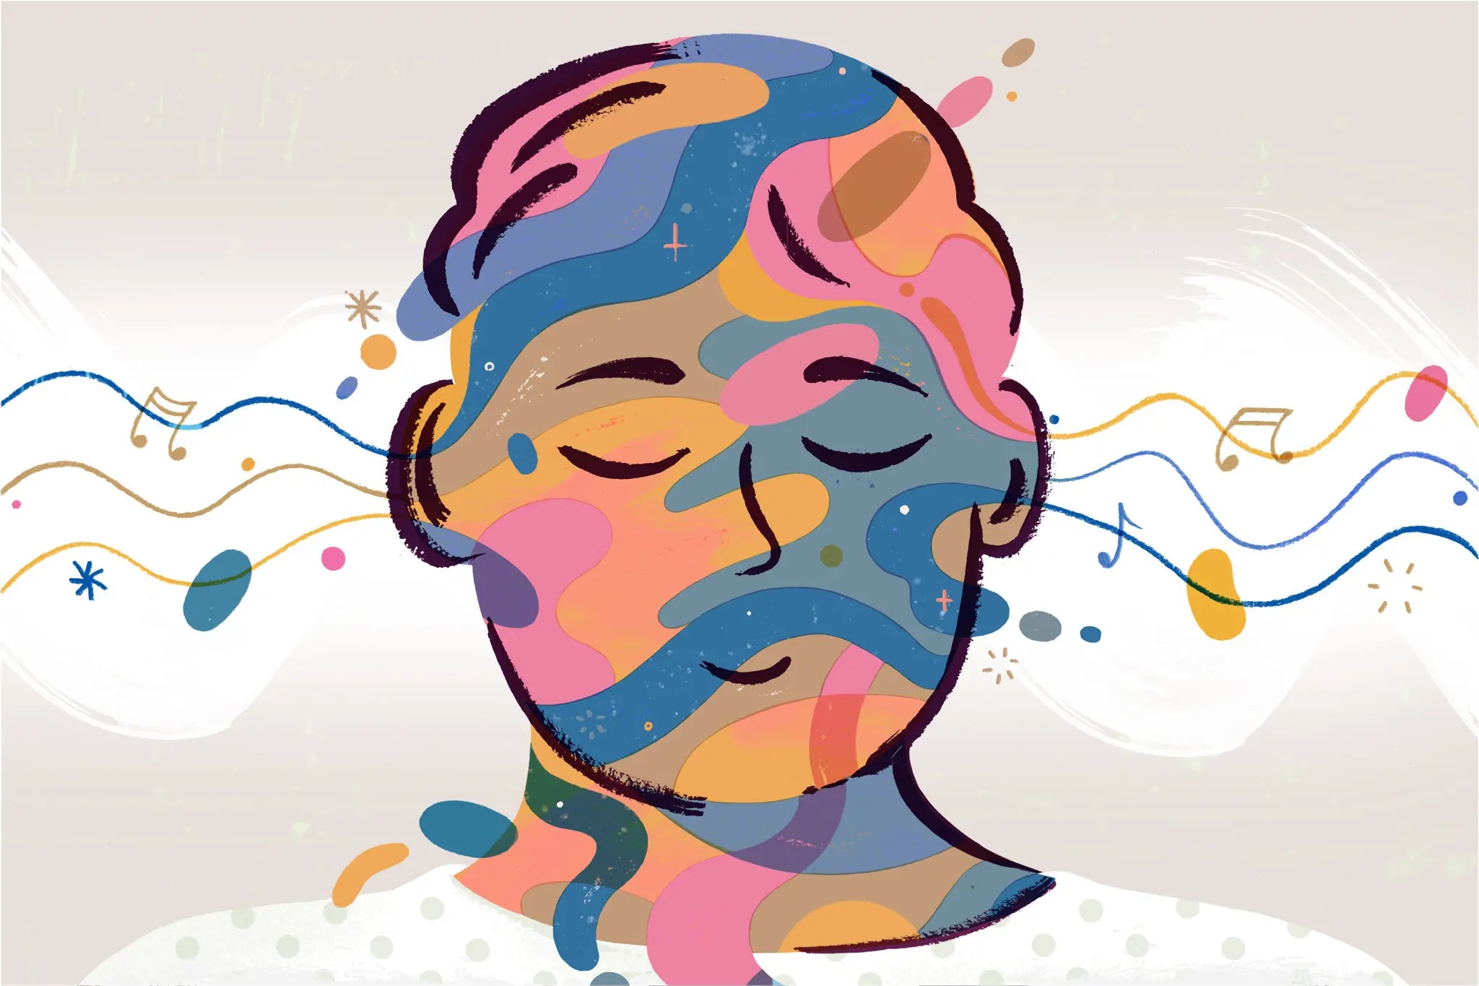

Investigating the Impact of Music on Mental Health: An Exploratory Analysis
By: C292 Pod C

Slide 2
Table of Contents
Introduction
Overview of the Data
Comparison and Analysis of Data
Conclusion and Recommendations
Q&A

Slide 3
Introduction

Slide 4

Introduction
Origin of the data:
A survey conducted in 2022 using Google forms
Shared in various social media platforms (Reddit and Discord)
Results were uploaded in Kaggle for exploratory analysis
Dataset was cleaned using Python
A combination of Python and Tableau was used to create visualizations.

Slide 5




Meet the team
Ana Nieva
Sarah Lipoff
Sory Sall
Alana Crumbley

Slide 6


Social Workers and Mental Health Counselors
The Purpose of our Exploratory Analysis:
Our Client:
Identify the most prevalent mental health conditions
Investigate connections between mental health conditions and the most affected demographics
Examine relationships between demographics, hours of listening to music, and its impact on mental health
Explore correlations between music genres and the mental health conditions
Generate actionable recommendations for our client

Slide 7
Overview of the Data

Slide 8
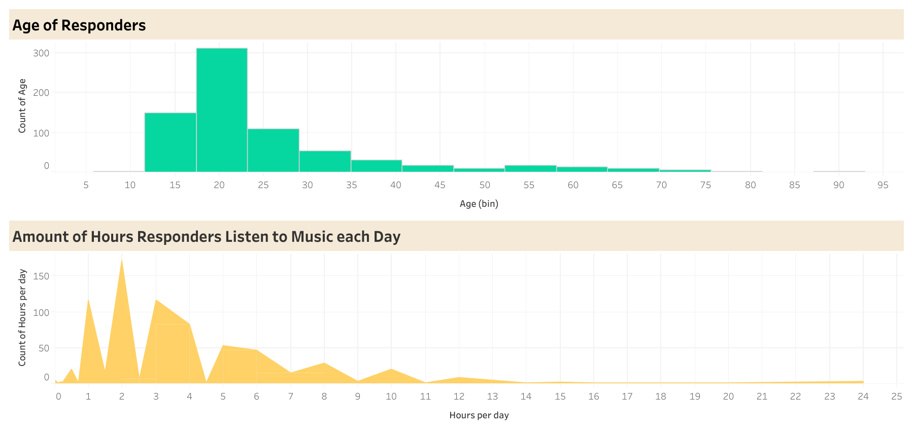
Amount of Survey Responders: 725
Responders were asked for their age and the amount of hours they listen to music each day
Most responders are between 12-29 years old and listen to music 1-3 hours per day

Slide 9
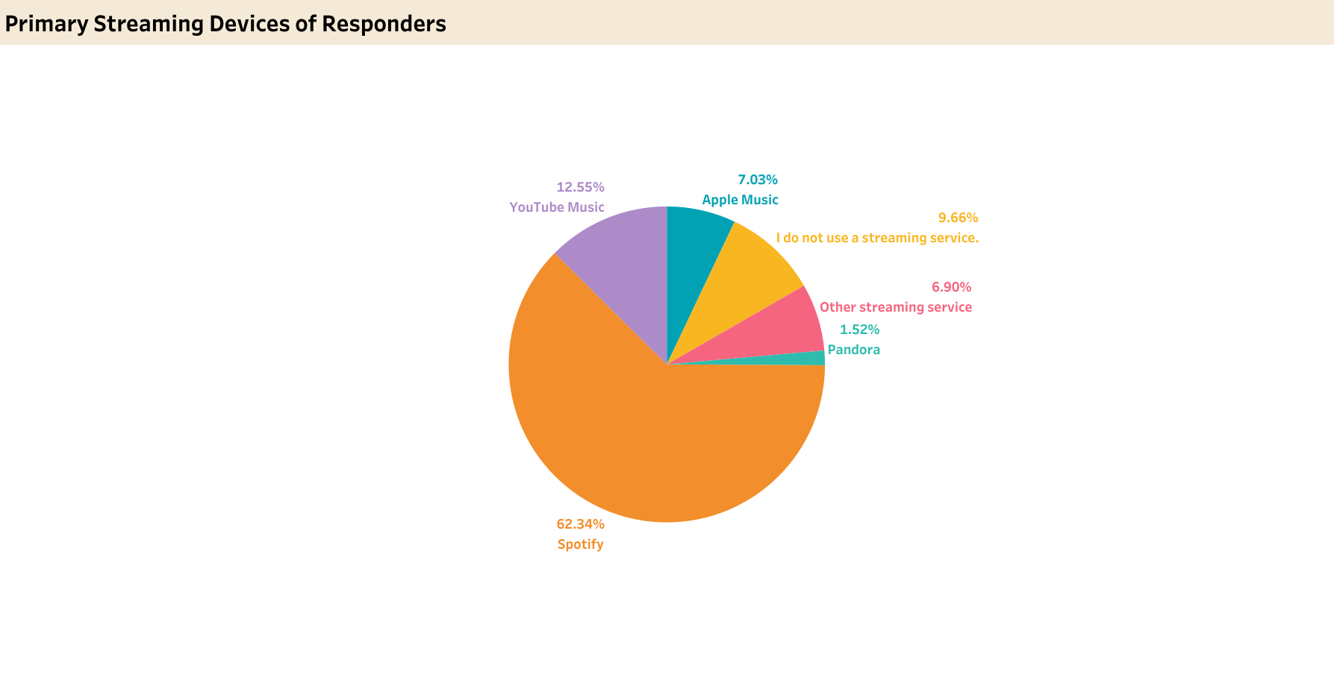
Responders were asked for their primary streaming device
Most responders use Spotify, then YouTube Music

Slide 10
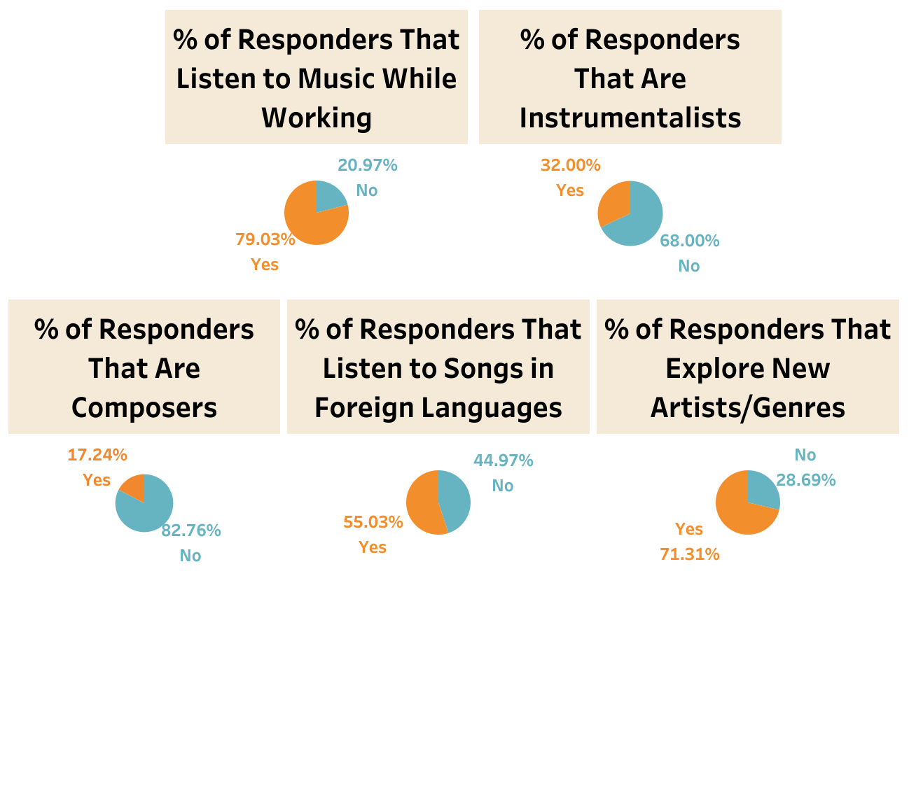
Responders were asked if do they…
Listen to music while working
Explore new artists/genres
Listen to songs in foreign languages
Most responders said yes
Notes:
About 79% of the responders listen to music while working | About 71% of the responders explore new artists/genres | About 55% of the responders listen to songs in foreign languages

Slide 11
Responders were asked if they consider themselves…
A Composer
An Instrumentalist
Does not apply to most responders
Notes:
Less than 30% of the responders neither consider themselves instrumentalists or composers

Slide 12
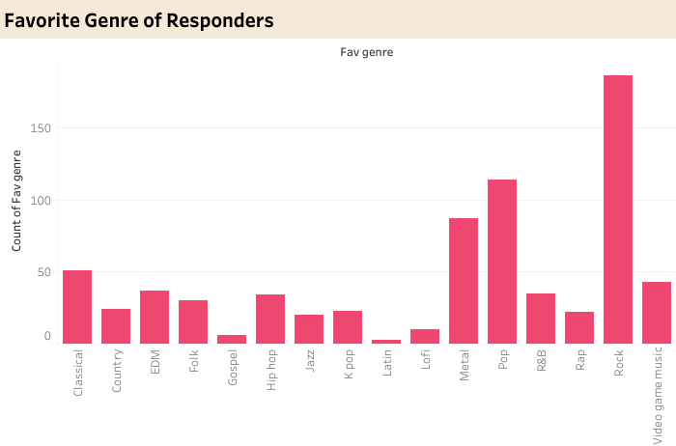
Responders were asked what is their favorite genre
Most responders listen to Rock, Pop and Metal

Slide 13
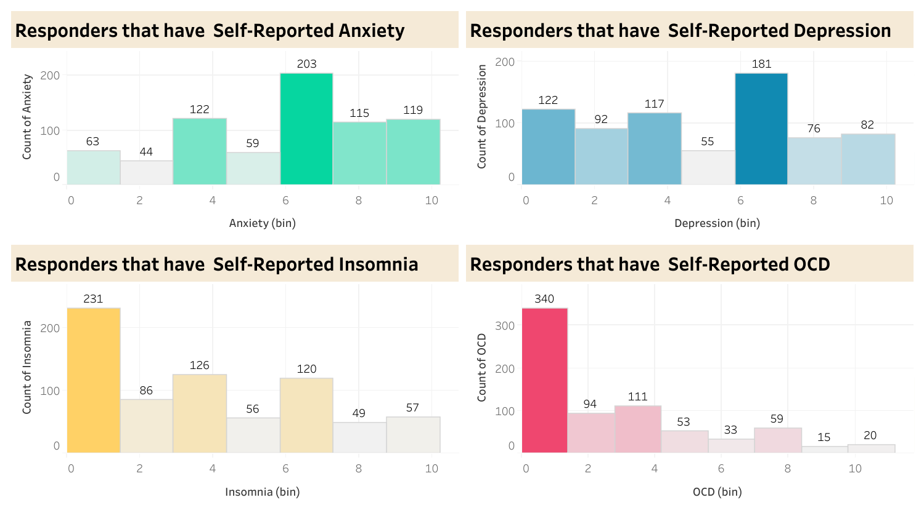
Responders were asked to rank themselves on how frequently they feel Anxiety, Depression, Insomnia, and OCD, on a scale of 0 to 10
0 = I do not experience this and 10 = I experience this regularly, constantly/or to an extreme.
Most responders feel no Insomnia and OCD, but most feel Anxiety and Depression

Slide 14
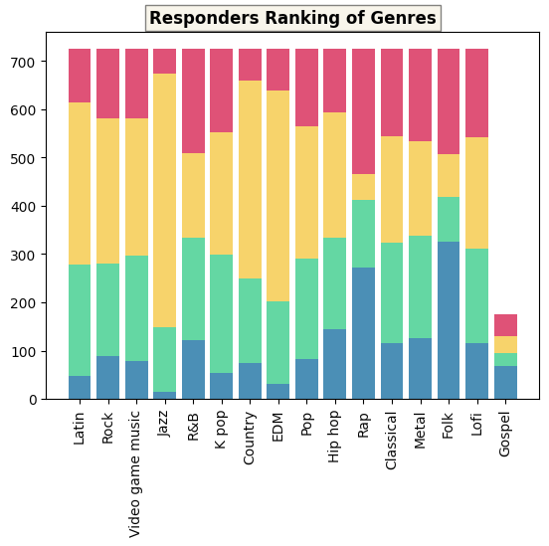
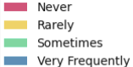
Responders were asked on how frequently they listen to each of the music genres
Frequency ranges from Never, Rarely, Sometimes, to Very Frequently
Gospel music is not very common to the responders
Most responders rarely listen to Jazz, EDM, and Country music
There’s almost the same amount of responders that said “Never and “Very Frequently” when asked if they listen to Rap music
Most of the responders listen to Folk music very frequently

Slide 15
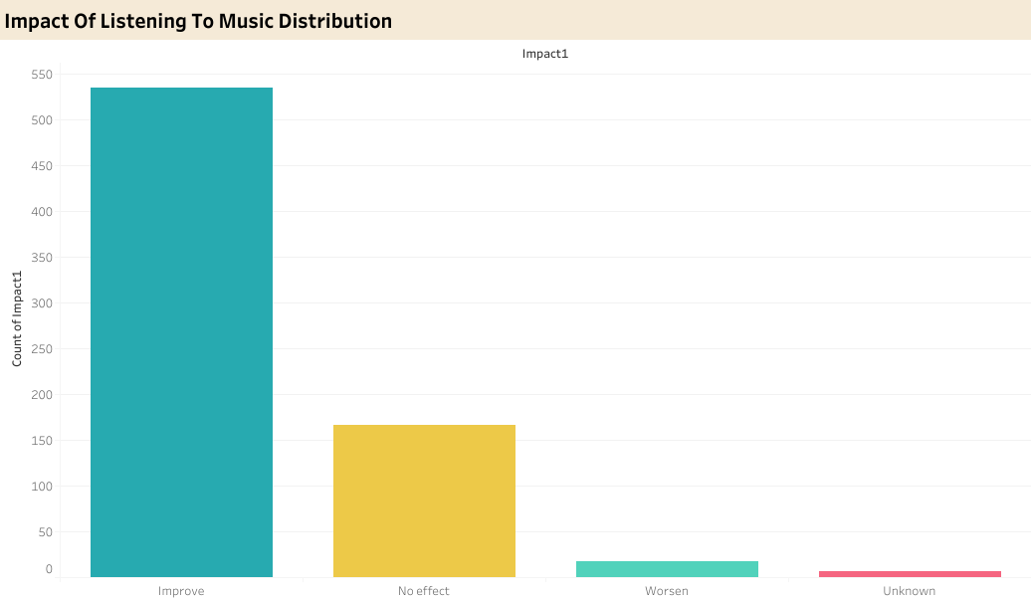
Responders were asked on how does listening to music impact their mental health
Choices are either Unknown, Worsen, No Effect, or Improve
Most responders claim that listening to music has improved their mental health

Slide 16
Comparison and Analysis of Data

Slide 17
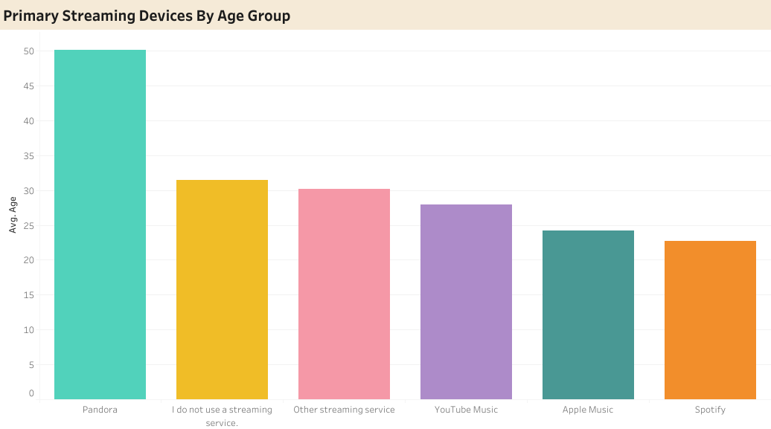
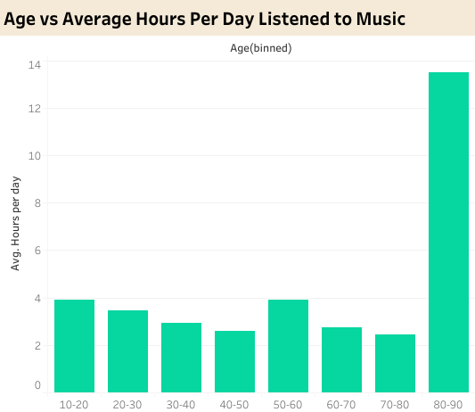
Comparison of Age with Hours Listened to Music and with Streaming Devices
Responders that are aged 80-90 listen to music the longest
Average age of users that use Pandora to listen to music is higher (50) than those of YouTube, Apple Music, and Spotify (23-31)

Slide 18
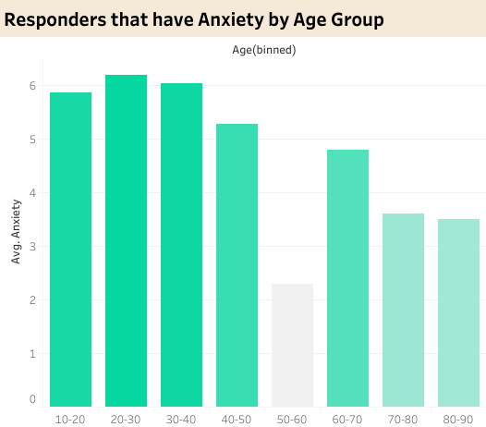
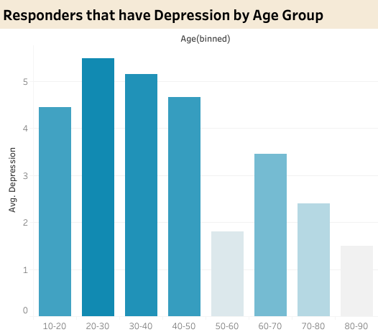
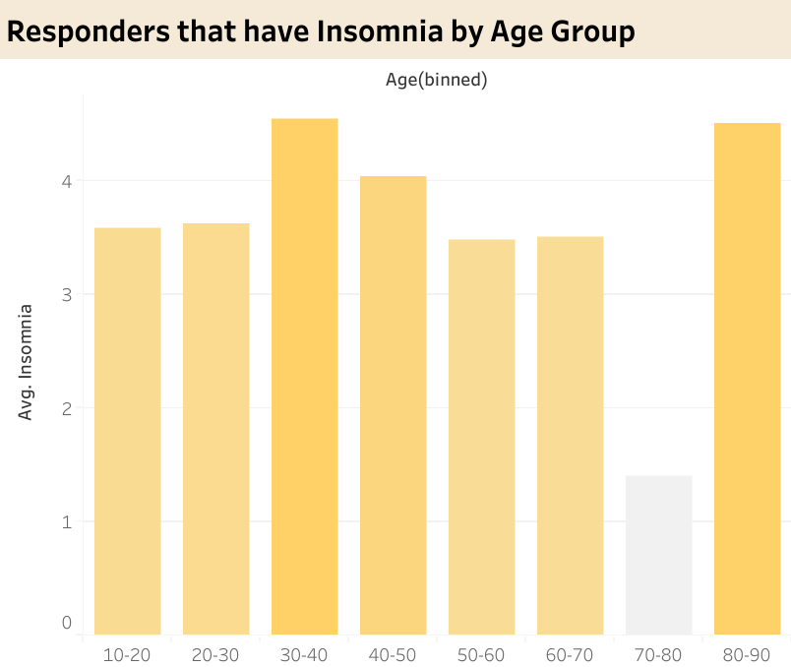
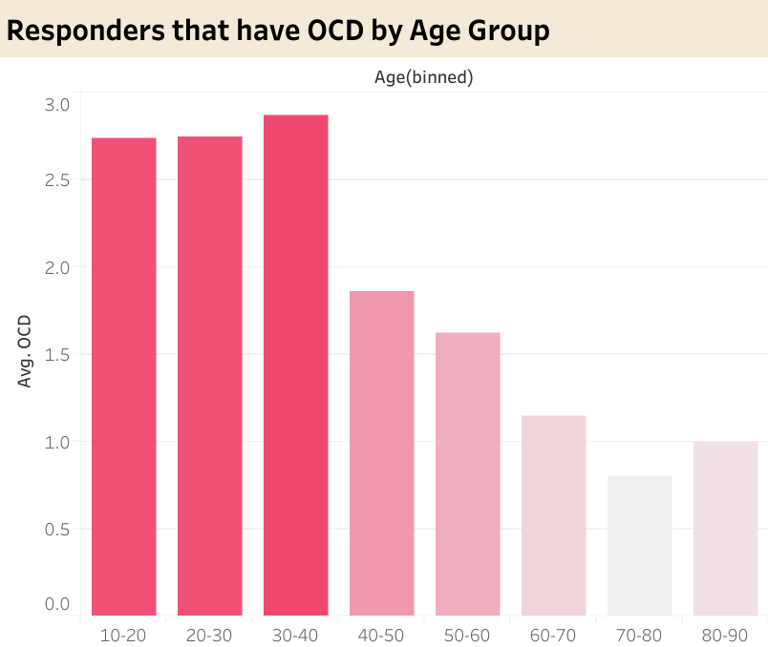
Comparison of Age with various Mental Health Conditions
Most responders ages 10-50 have anxiety and depression
No correlation between age groups and insomnia
Most responders ages 10-30 have OCD

Slide 19
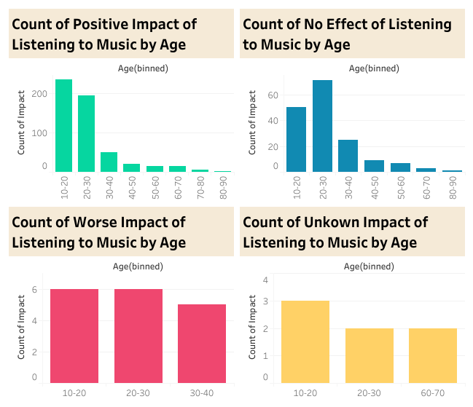
Comparison of Impact with Age Groups
Listening to music has a positive impact on most 10-20 year old responders
Listening to music has no effect on most 20-30 year old responders

Slide 20
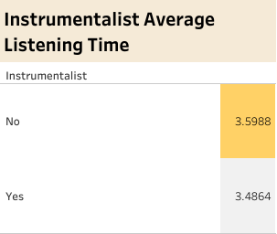
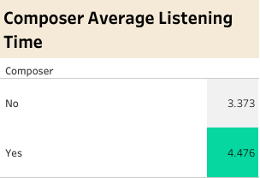
Comparison of Hours Listened to Music with Composers and Instrumentalists
Non-instrumentalists listen to music slightly a bit longer than instrumentalists
Composers listen to music longer than non-composers

Slide 21
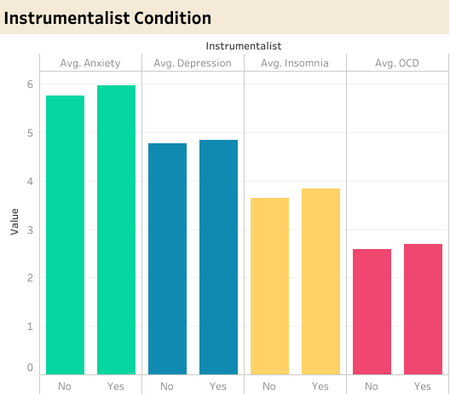
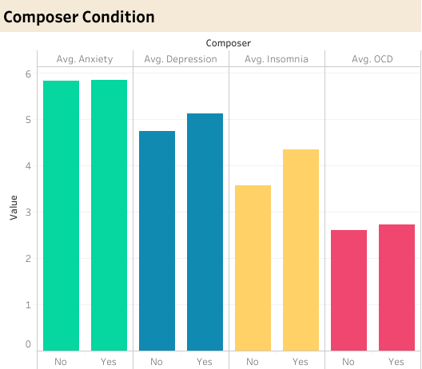
Comparison of Mental Health Conditions with Composers and Instrumentalists
The responders that claimed to be composers and instrumentalists have a slightly higher anxiety, depression, insomnia, and OCD than those who aren’t

Slide 22
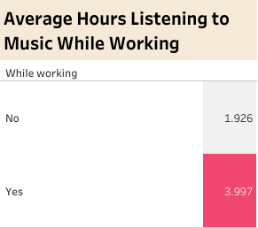
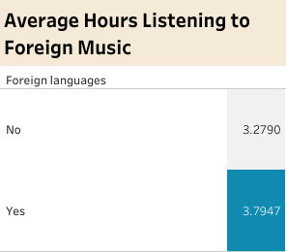
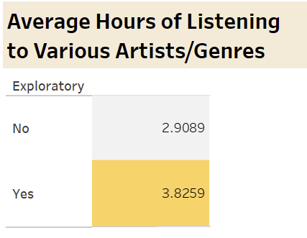
Comparison of Hours Listened to Music with…
Responders said yes to each of the categories/questions listen to music for 3.7-3.9 hours

Slide 23
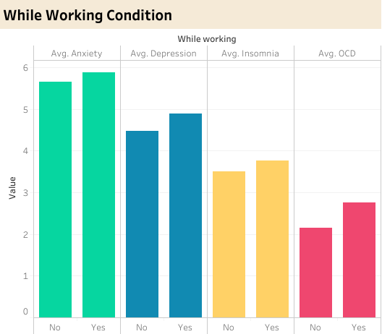
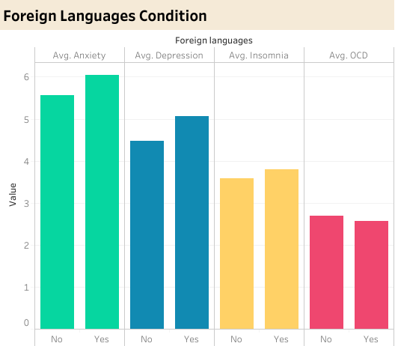
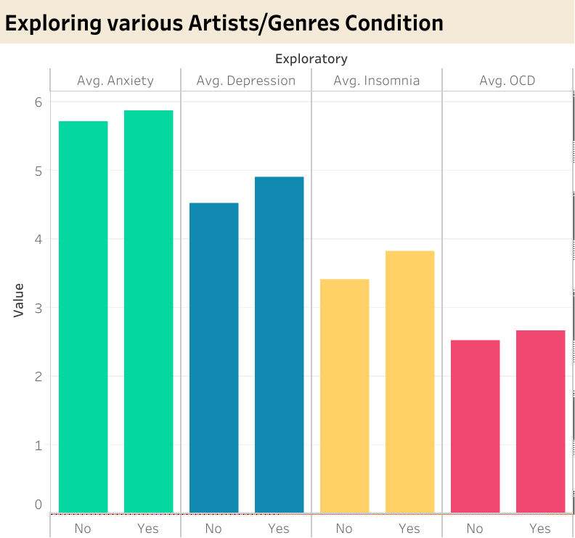
Comparison of Mental Health Conditions with responders who…
Listen to music while working
Listen to songs in foreign languages
Explore new artists/genres
The responders that said yes to each have a slightly higher anxiety, depression, insomnia, and OCD than those who answered no

Slide 24
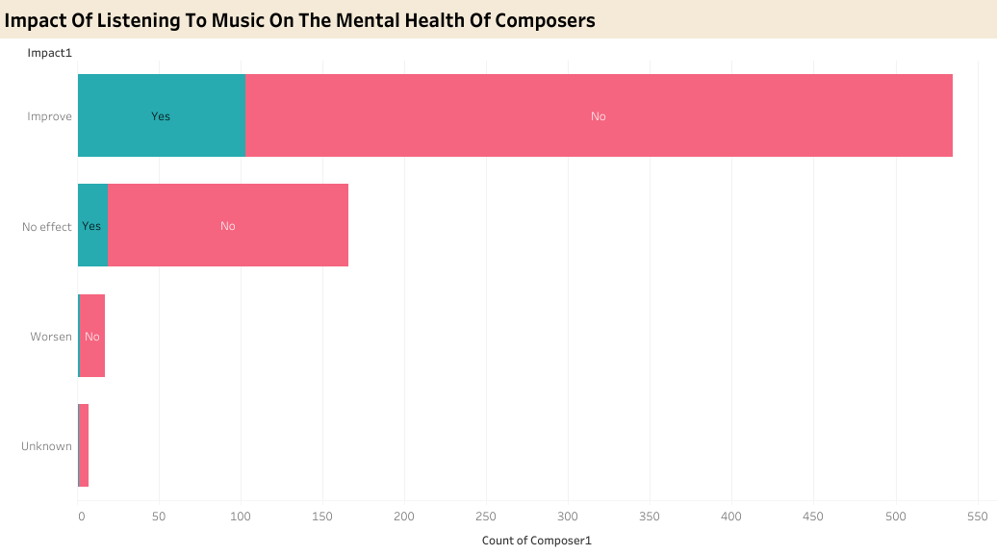
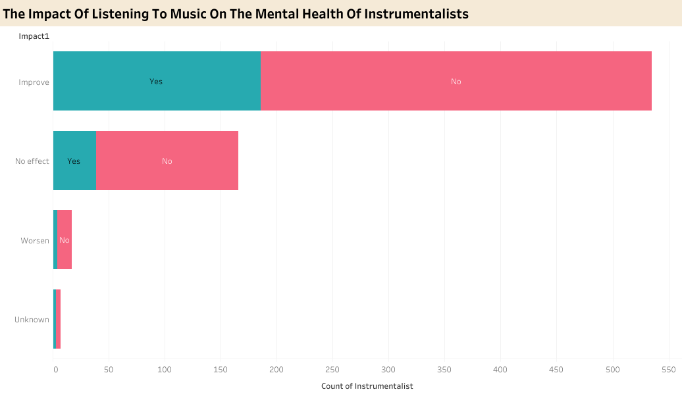
Comparison of Impact with Composers and Instrumentalists
Listening to music as a composer or instrumentalist has no impact in improving mental health

Slide 25
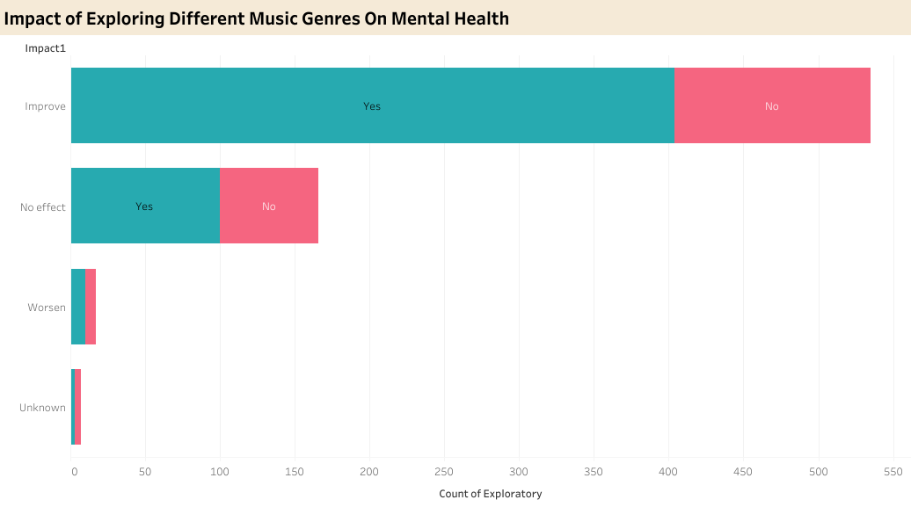
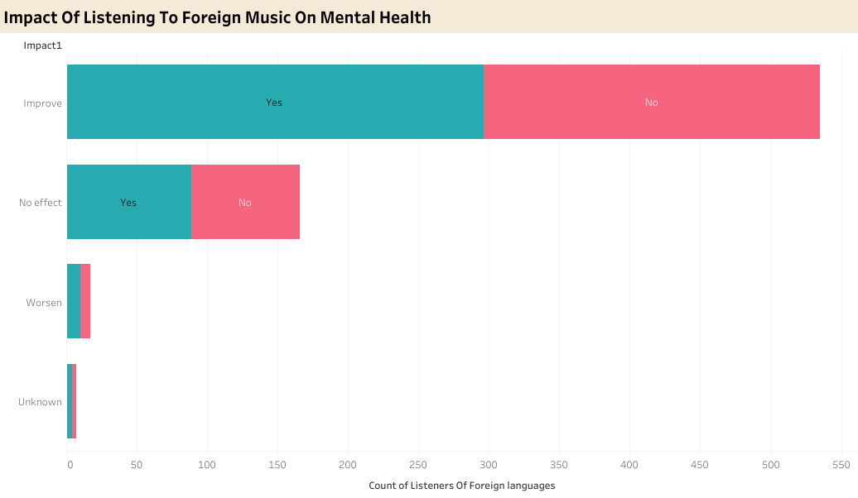
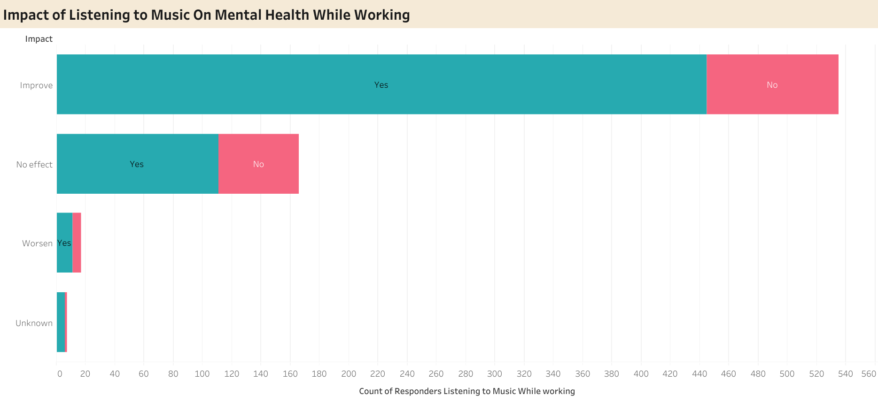
Comparison of Impact with…
Exploring new artists/genres
Listening to songs in foreign languages
Listening to music while working
Each of these has mostly helped improve mental health conditions

Slide 26
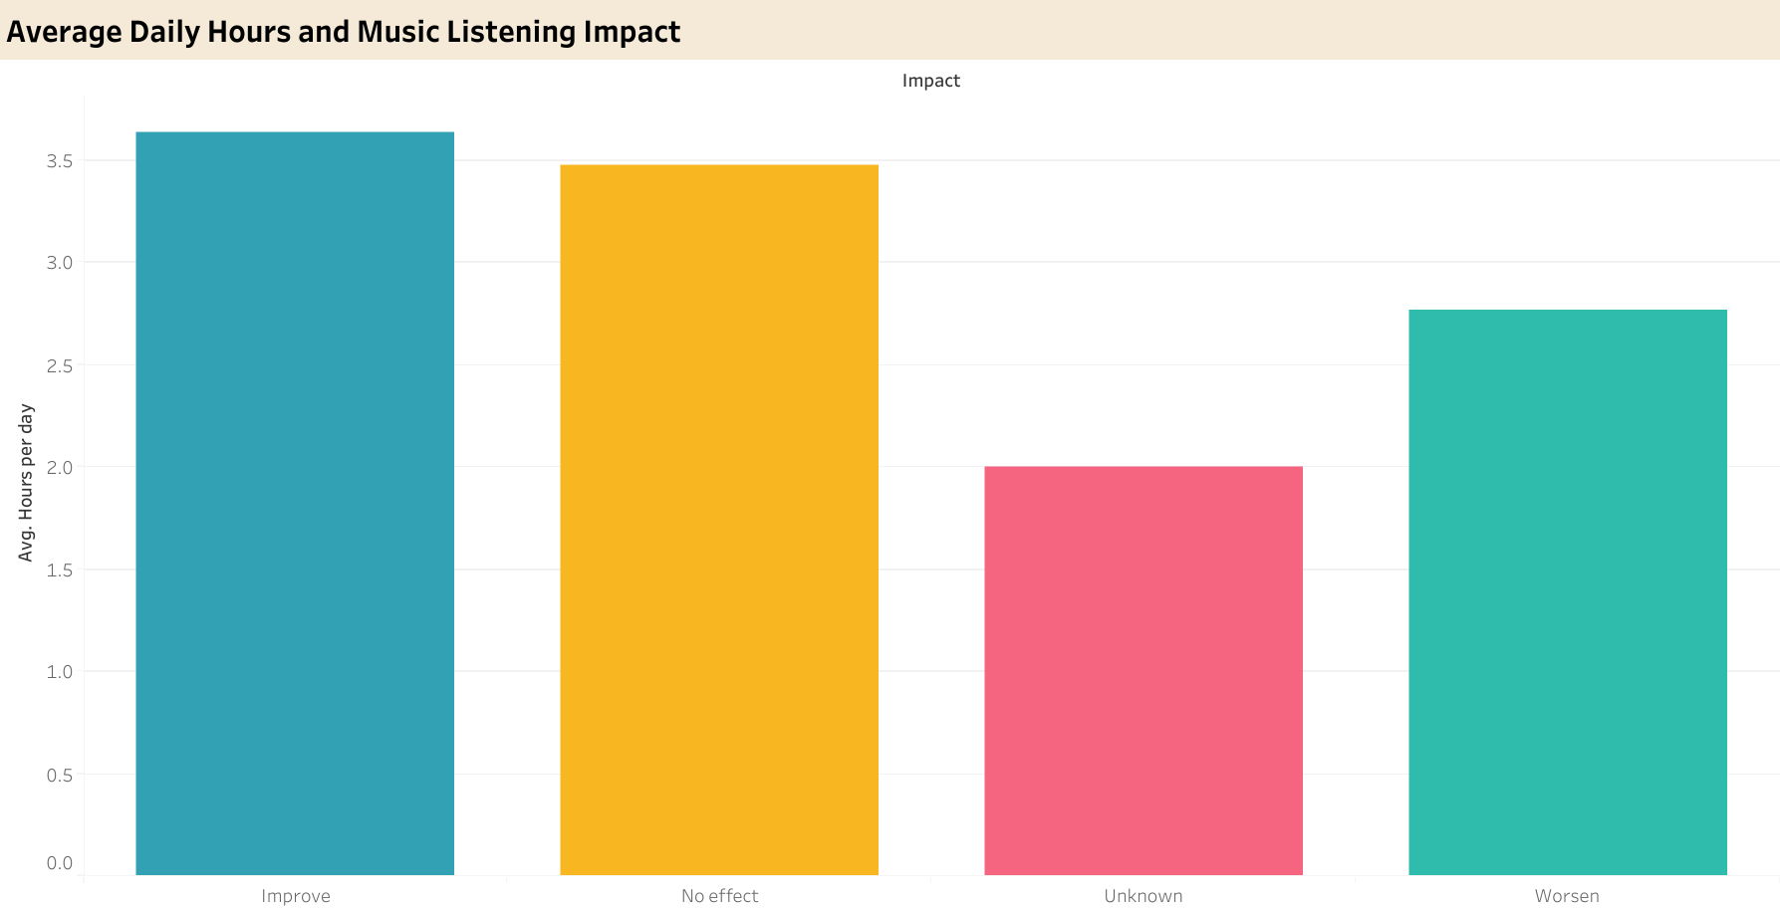
Comparison of Hours of Listening to Music and its Impact on Mental Health
Listening to music for more hours has improved the mental health of responders

Slide 27
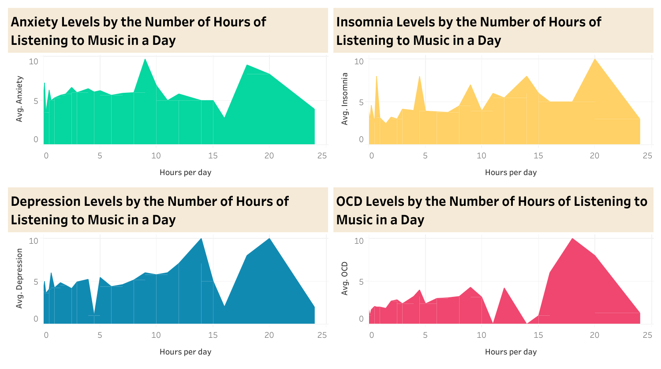
Comparison of Mental Health Conditions and Hours of Listening to Music
No correlation exists between the increasing levels of the mental health conditions of responders and the amount of hours they listen to music

Slide 28
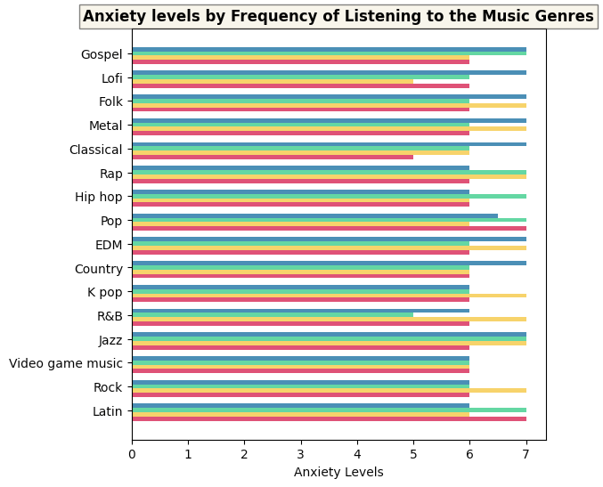
Comparison of Anxiety Levels and the Genres
Listening to Gospel, Lofi, Folk, Metal, Classical, EDM, Country and Jazz “Very Frequently” has a high correlation to high Anxiety Levels

Slide 29
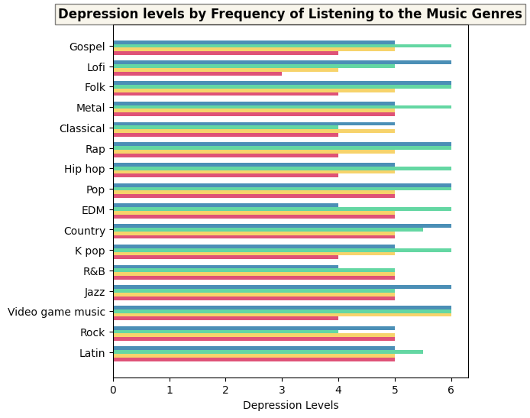
Comparison of Depression Levels and the Genres
Listening to Lofi, Folk, Rap, Pop, Country, Jazz, and Video Game Music “Very Frequently” has a high correlation to high Depression Levels

Slide 30
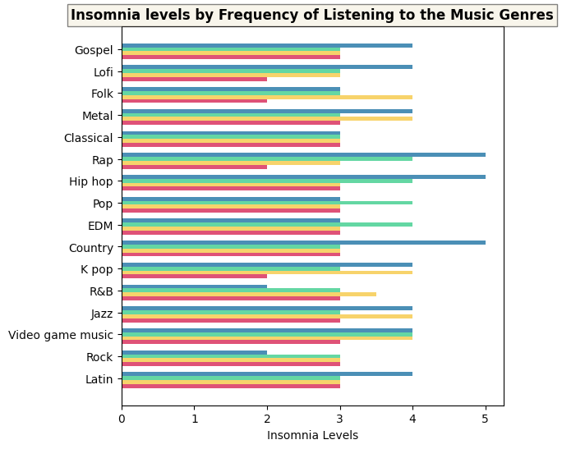
Comparison of Insomnia Levels and the Genres
Listening to Rap, Hip hop, and Country “Very Frequently” has a high correlation to high Insomnia Levels

Slide 31
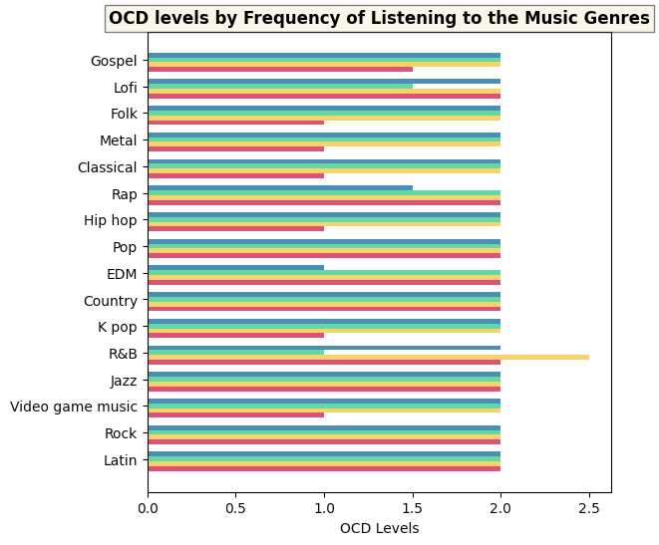
Comparison of OCD Levels and the Genres
Listening to R&B “Rarely” has a high correlation to the high levels of OCD

Slide 32
Conclusion and Recommendations

Slide 33
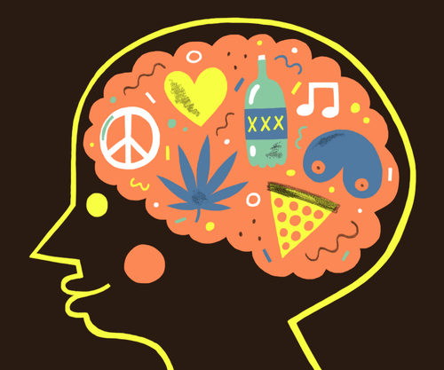
Conclusion
Anxiety and depression are the most prevalent mental health conditions after this study.
Survey patterns have indicated that anxiety and depression are commonly seen in 10-50 year old individuals
Listening to music has been shown to improve mental health, with younger age groups between 10 and 30 years old benefiting the most.
However, there are some 20-30 year olds claimed that listening to music had no effect on them.

Slide 34

Conclusion (continued)
While there is no set duration for how long one with mental health conditions should listen to music, majority of the responders listen for 3-4 hours a day.
At the end, most have claimed that their mental health conditions improved
Listening to Country music very frequently has a high correlation with high anxiety, depression and insomnia levels; listening to Lofi very frequently has a high correlation with high anxiety and depression

Slide 35
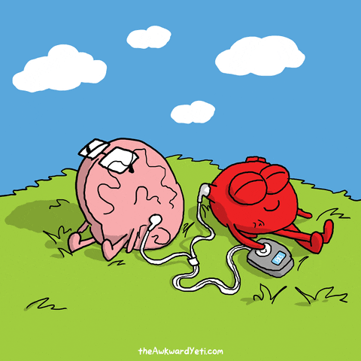
Recommendations
As social workers and mental health counselors encourage music therapy to their clients they should,
Tell their patients to listen to music for about 3-4 hours per day, regardless of their mental health conditions
As to genres, try to gauge to your patients’ music preferences, then from there, recommend which genre(s) would be more or less helpful to their mental health condition

Slide 36
Resources
“Music & Mental Health Eda.” Kaggle, Kaggle, 18 Dec. 2022, https://www.kaggle.com/code/catherinerasgaitis/music-mental-health-eda/notebook.
Rasgaitis, Catherine. “Music & Mental Health Survey Results.” Kaggle, 21 Nov. 2022, https://www.kaggle.com/datasets/catherinerasgaitis/mxmh-survey-results.

Slide 37
Thank You!
Questions?

